Slide 1

Department of Computer Science Gujarat University
5 Year Integrated M.Sc.(Computer Science)
Semester - III
Website for Department of Computer science
Presented By:
Ansh Yadav (30027)
Ankit Yadav (30028)
Harsh Dedakiya (30007)
Under the Guidance of :
Dr. Khyati Rami

Slide 2
Table of Content
Project Profile
Tools and Language
Project Description
Website Module
System Design
Data Dictionary
Screenshots
Future Work
Bibliography

Slide 3
Project Profile
Website for “Maharishi Pingla, School of Advance Computing and Information Technology ”.
It is define to created easy way of communication between the department and it’s students.

Slide 4
Tools & Languages
Front End Tools | Back End Tools | Software Tools
Bootstrap | MySQL | VS Code
HTML | PHP | XAMPP Server
CSS
JavaScript

Slide 5
Project Description
Admin
Maintain logins
Update/Delete Faculty Details
Update/Delete/ Student Details
Create New Event
Update/Delete Events
Insert/Update/Delete Syllabus
View Event lists
View list of Course and its syllabus
View overview of event in dashboard and reports.
View of complete dashboard
Faculty
Create/Update/Delete Research
View Syllabus
View Research Dashboard
View overall dashboard
Student
View Syllabus
View Research
View events
view overall dashboard

Slide 6
ADMIN CASE DIAGRAM :
Maintain logins(Admin, Faculty, Student)
Update/ Delete Faculty
Update/ Delete Student Details
Create New Event
Update/ Delete event
Insert/ Update / Delete Syllabus
ADMIN
View Events List
View Courses and Syllabus
View Events Feedbacks

Slide 7
FACULTY-STUDENT CASE DIAGRAM :
Create/Update/Delete Research
View Syllabus
FACULTY
View Research
View Events
STUDENT
View Events Feedbacks

Slide 8
System Flow

Slide 9
Department Of Computer Science
Home
Academics
Faculty
Events
About
Sign in
Search
Sign up
Registration
(With Mail Authentication)
Sign In

Slide 10
Academics
PhD [COMPUTER SCIENCE]
MCA
PGDCA
AI & ML
AI & ML& DEFENCE
FIVE YEAR INTEGRATED MSCCS
M.TECH-NC
M.TECH-WT

Slide 11
Faculty
Dr. Jyoti Pareek
Dr.Hiren Jyoshi
Dr.Kamaljit Lakhtaria
Dr.Hardik Joshi
Mr.Jaykumar Patel
Dr.Khyati Rami
Dr. Maitri Jhaveri
Dr.Suchit Purohit
Dr.Bhumika Shah
Dr. Jigna SatanI

Slide 12
Event
Seminar on Java Programming
Expert Lecture on Bhuvan’s Portal
Seminar on Artificial Intelligence and Machine Learning – “Marvels of AI”
Seminar on Virtual Labs by IIT, Mumbai
Participants of Seminar on Virtual Labs

Slide 13
Registration
Fetch mail
Generate OTP
Send OTP
Verify OTP
LOG IN
Submit details
Registration Process

Slide 14
Search Process
FETCH INPUT
SWITCH
(INPUT)
LOAD PAGE (KEYWORD1)
BREAK
CASE INPUT1
CASE INPUT2
LOAD PAGE (KEYWORD1)
BREAK
CASE INPUT3
LOAD PAGE (KEYWORD1)
BREAK
LOAD PAGE
ERROR PAGE
BREAK
DEFAULT
DEFAULT

Slide 15
Research Process
Login
Faculty
Student
Create research
Update/delete
research
view

Slide 16
EER Model

Slide 17
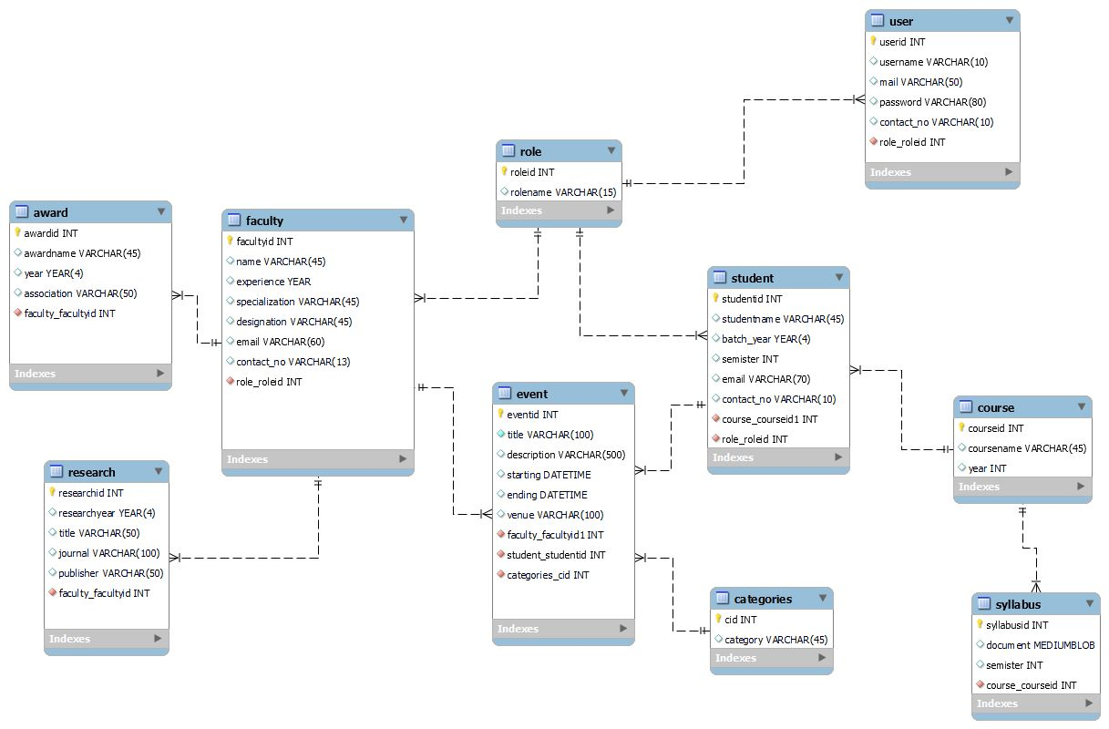

Slide 18
Data Dictionary

Slide 19
User Table
SERIAL NO | FIELD NAME | TYPE | SIZE | CONSTRAINS | SAMPLE DATA
1 | userid | INT | 11 | Primary key | a1
2 | username | VARCHAR | 10 |  | kapil
3 | mail | VARCHAR | 50 |  | kapil@gmail.com
4 | password | VARCHAR | 80 |  | $2y$10$RxS965y
5 | contact_no | VARCHAR | 10 |  | 1234567890
6 | role_roleid | INT | 11 | Foreign key, Not Null | 1

Slide 20
Role Table
SERIAL NO | FIELD NAME | TYPE | SIZE | CONSTRAINS | SAMPLE DATA
1 | roleid | INT | 11 | Primary key | 1
2 | rolename | VARCHAR | 15 |  | admin

Slide 21
Faculty Table
SERIAL NO | FIELD NAME | TYPE | SIZE | CONSTRAINS | SAMPLE DATA
1 | facultyid | INT | 11 | Primary key | 1
2 | name | VARCHAR | 45 |  | james
3 | years_in_dcs | INT | 3 |  | 6
4 | specialization | VARCHAR | 45 |  | xyz
5 | post | VARCHAR | 45 |  | Assistant projessor
6 | email | VARCHAR | 60 |  | james@gmail.com
7 | contact_no | VARCHAR | 13 |  | 1234567890
8 | role_roleid | INT | 11 | Foreign key, Not Null | 1

Slide 22
Research Table
SERIAL NO | FIELD NAME | TYPE | SIZE | CONSTRAINS | SAMPLE DATA
1 | researchid | INT | 11 | Primary Key | 1
2 | researchyear | YEAR | 4 |  | 2021
3 | title | VARCHAR | 50 |  | Experiments with Different Indexing Techniques for Text Retrieval tasks on Gujarati Language using Bag-of-Words Approach
4 | journal | VARCHAR | 100 |  | xyz
5 | publisher | VARCHAR | 50 |  | CIIT International Journal of Data Mining and Knowledge Engineering
6 | faculty_facultyid | INT | 11 | Foreign key | 2

Slide 23
Award Table
SERIAL NO | FIELD NAME | TYPE | SIZE | CONSTRAINS | SAMPLE DATA
1 | awardid | INT | 11 | Primary key | 1
2 | awardname | VARCHAR | 45 |  | nixi fellowship
3 | year | YEAR | 4 |  | 2014
4 | association | VARCHAR | 50 |  | nixi
5 | work | VARCHAR | 70 |  | xyz
6 | faculty_facultyid | INT | 11 | Foreign key, Not null | 2

Slide 24
Event Table
SERIAL NO | FIELD NAME | TYPE | SIZE | CONSTRAINS | SAMPLE DATA
1 | eventid | INT | 11 | Primary key | 1
2 | title | VARCHAR | 100 |  | Bhuvan Portal
3 | description | VARCHAR | 500 |  | Lecture of Bhuvan portal
4 | starting | DATETIME |  |  | 08-01-2023 02:30:00
5 | ending | DATETIME |  |  | 08-01-2023 02:30:00
6 | venue | VARCHAR | 100 |  | Conventional Hall
7 | faculty_facultyid | INT | 11 | Foregin key, Not Null | 2
8 | student_studentid | INT | 11 | Foregin key, Not Null | 112

Slide 25
Student Table
SERIAL NO | FIELD NAME | TYPE | SIZE | CONSTRAINS | SAMPLE DATA
1 | studentid | INT | 11 | Primary key | 1
2 | studentname | VARCHAR | 45 |  | alex
3 | batch_year | YEAR |  |  | 2021
4 | semister | INT | 11 |  | 3
5 | email | VARCHAR | 70 |  | alex@gmail.com
6 | contact_no | VARCHAR | 10 |  | 1234567890
7 | course_courseid1 | INT | 11 | Foreign key, Not Null | 2
8 | role_roleid | INT | 11 | Foreign key, Not Null | 2

Slide 26
Category Table
SERIAL NO | FIELD NAME | TYPE | SIZE | CONSTRAINS | SAMPLE DATA
1 | cid | INT | 11 | Foreign Key | 1
2 | category | VARCHAR | 45 |  | Seminar

Slide 27
Syllabus Table
Course Table
SERIAL NO | FIELD NAME | TYPE | SIZE | CONSTRAINS | SAMPLE DATA
1 | courseid | INT | 11 | Primary key | 1
2 | coursename | VARCHAR | 45 |  | integrated msc(cs)
3 | year | INT | 11 |  | 5
SERIAL NO | FIELD NAME | TYPE | SIZE | CONSTRAINS | SAMPLE DATA
1 | syllabusid | INT | 11 | Primary key | 1
2 | document | MEDIUMBLOB |  |  | [BLOB - 35 B]
3 | semister | INT | 11 |  | 3
4 | course_courseid | INT | 11 |  | 2

Slide 28
Screenshots

Slide 29
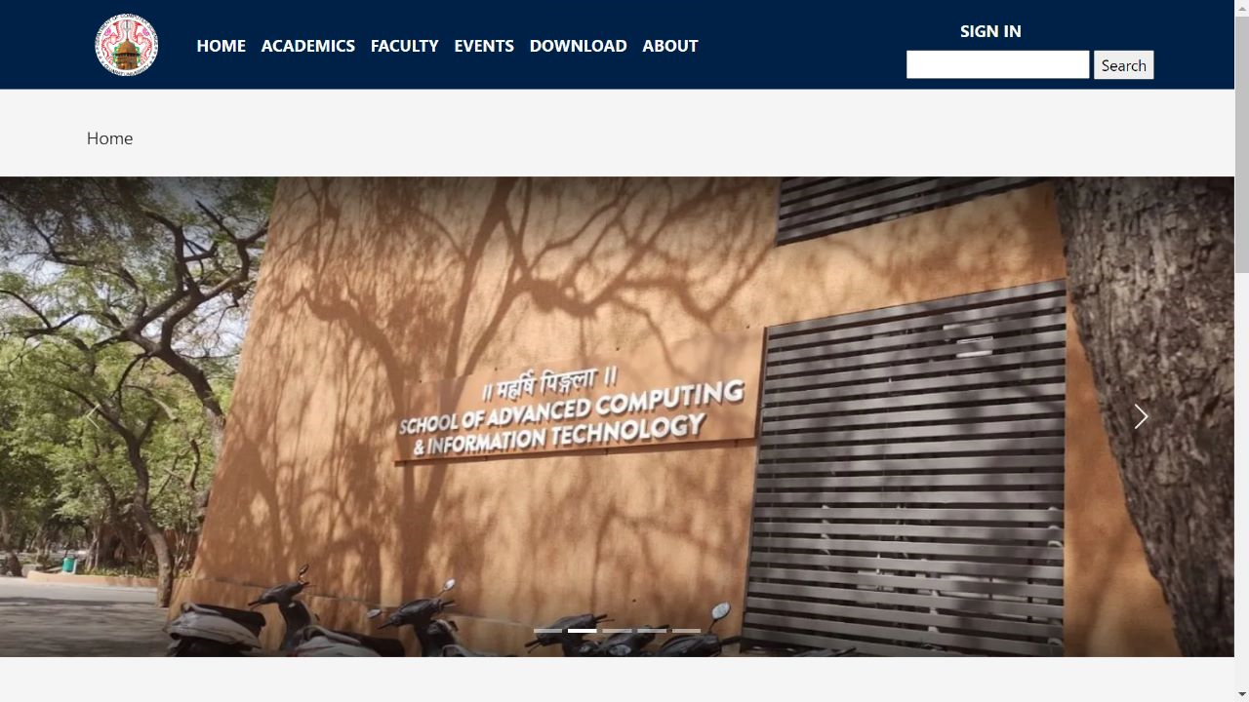
Home

Slide 30
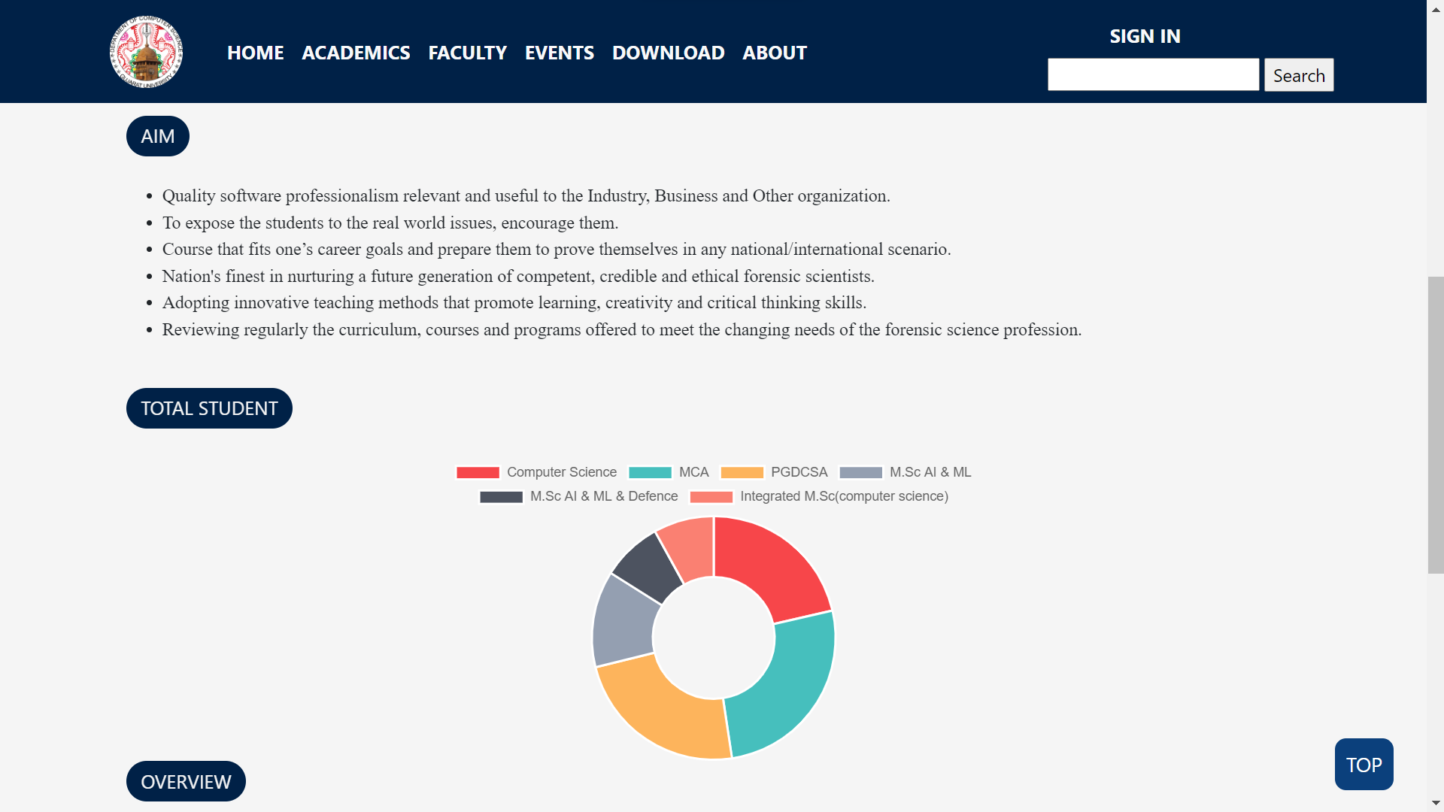
Home

Slide 31
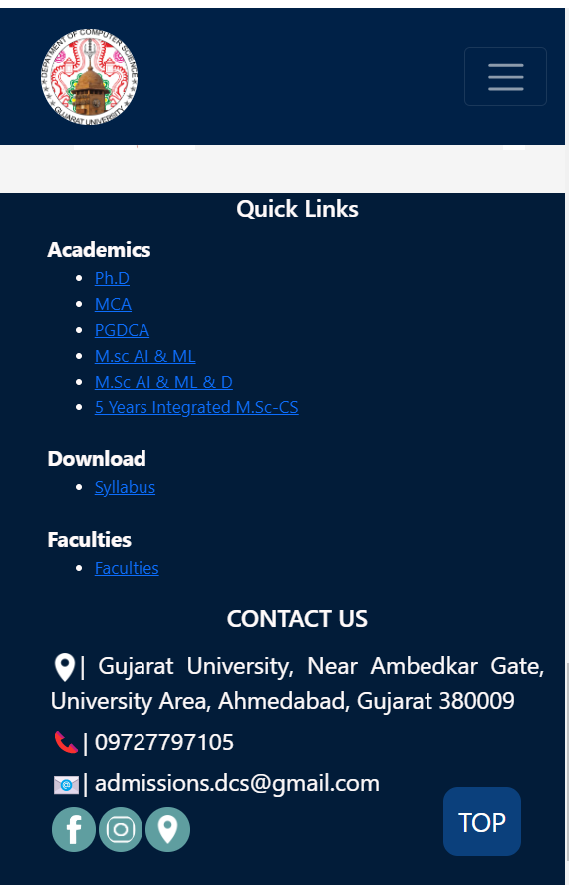
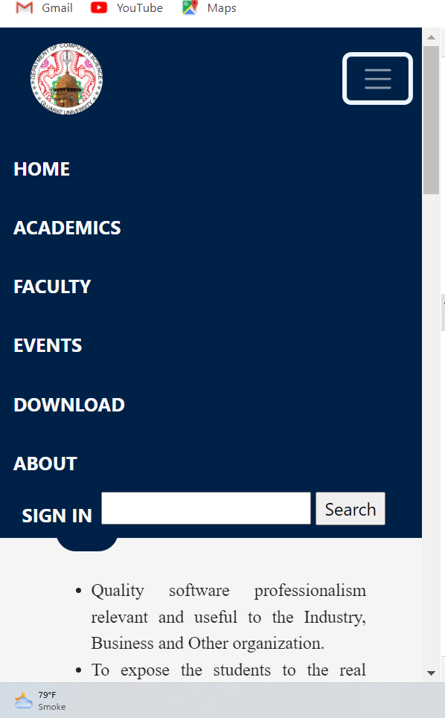
Header & Footer

Slide 32
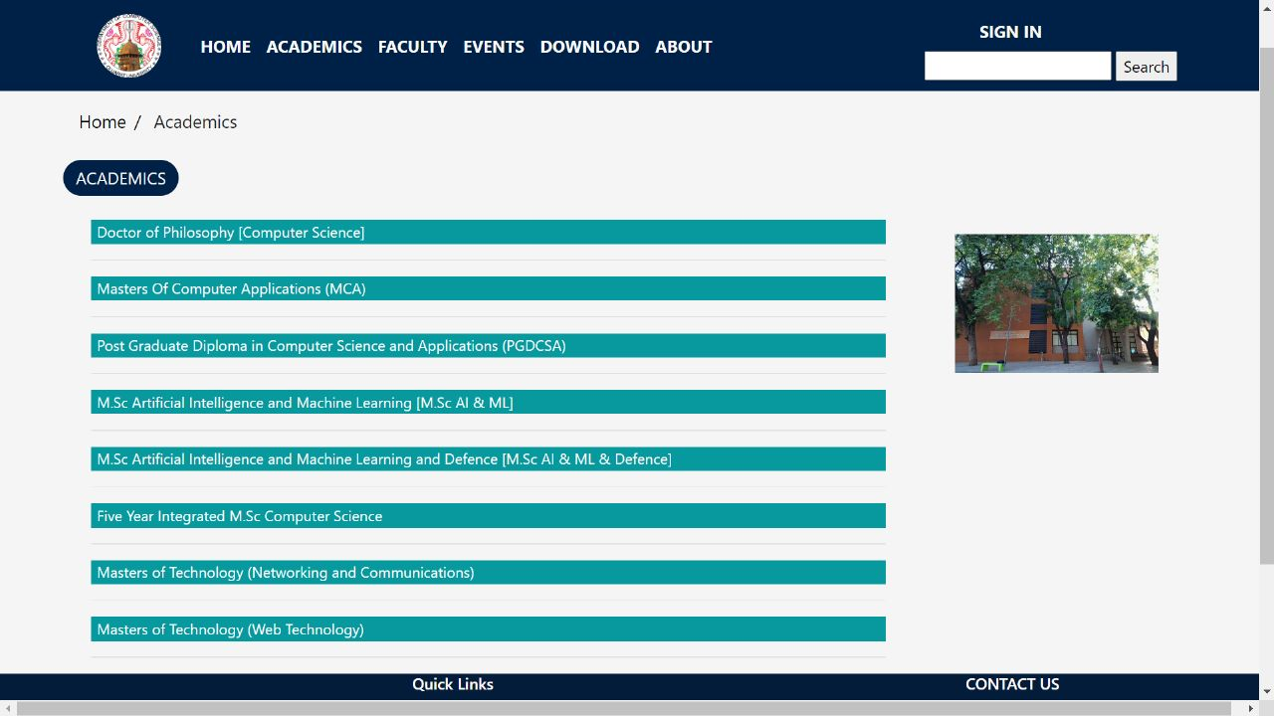
Academics

Slide 33
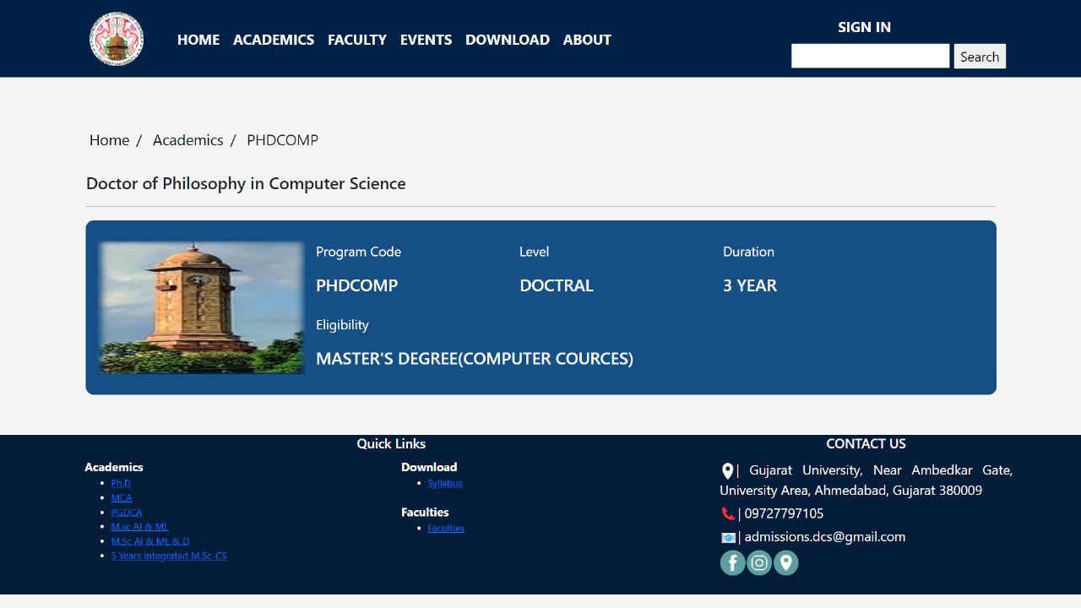
Academics

Slide 34
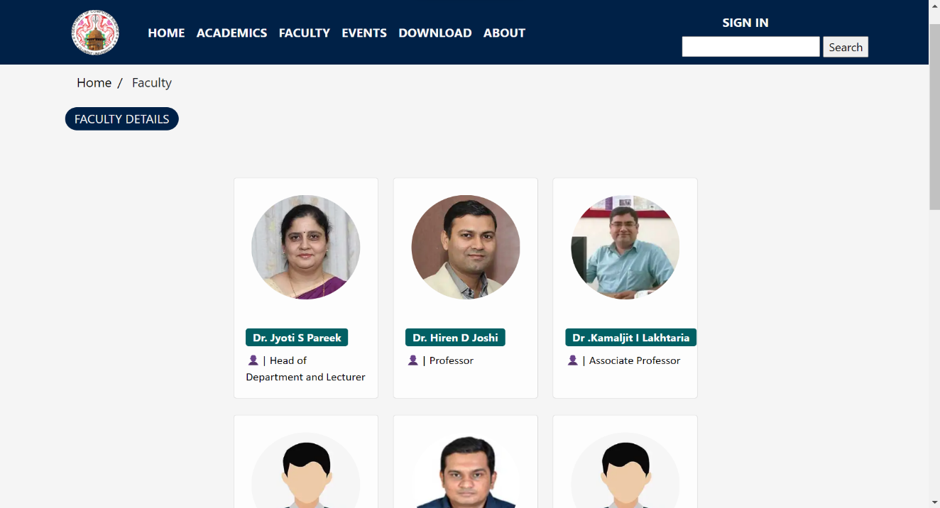
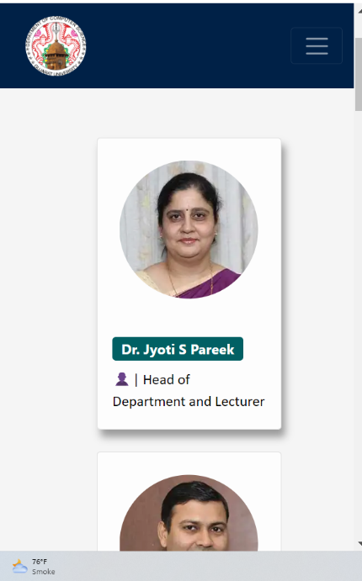
Faculty Page

Slide 35
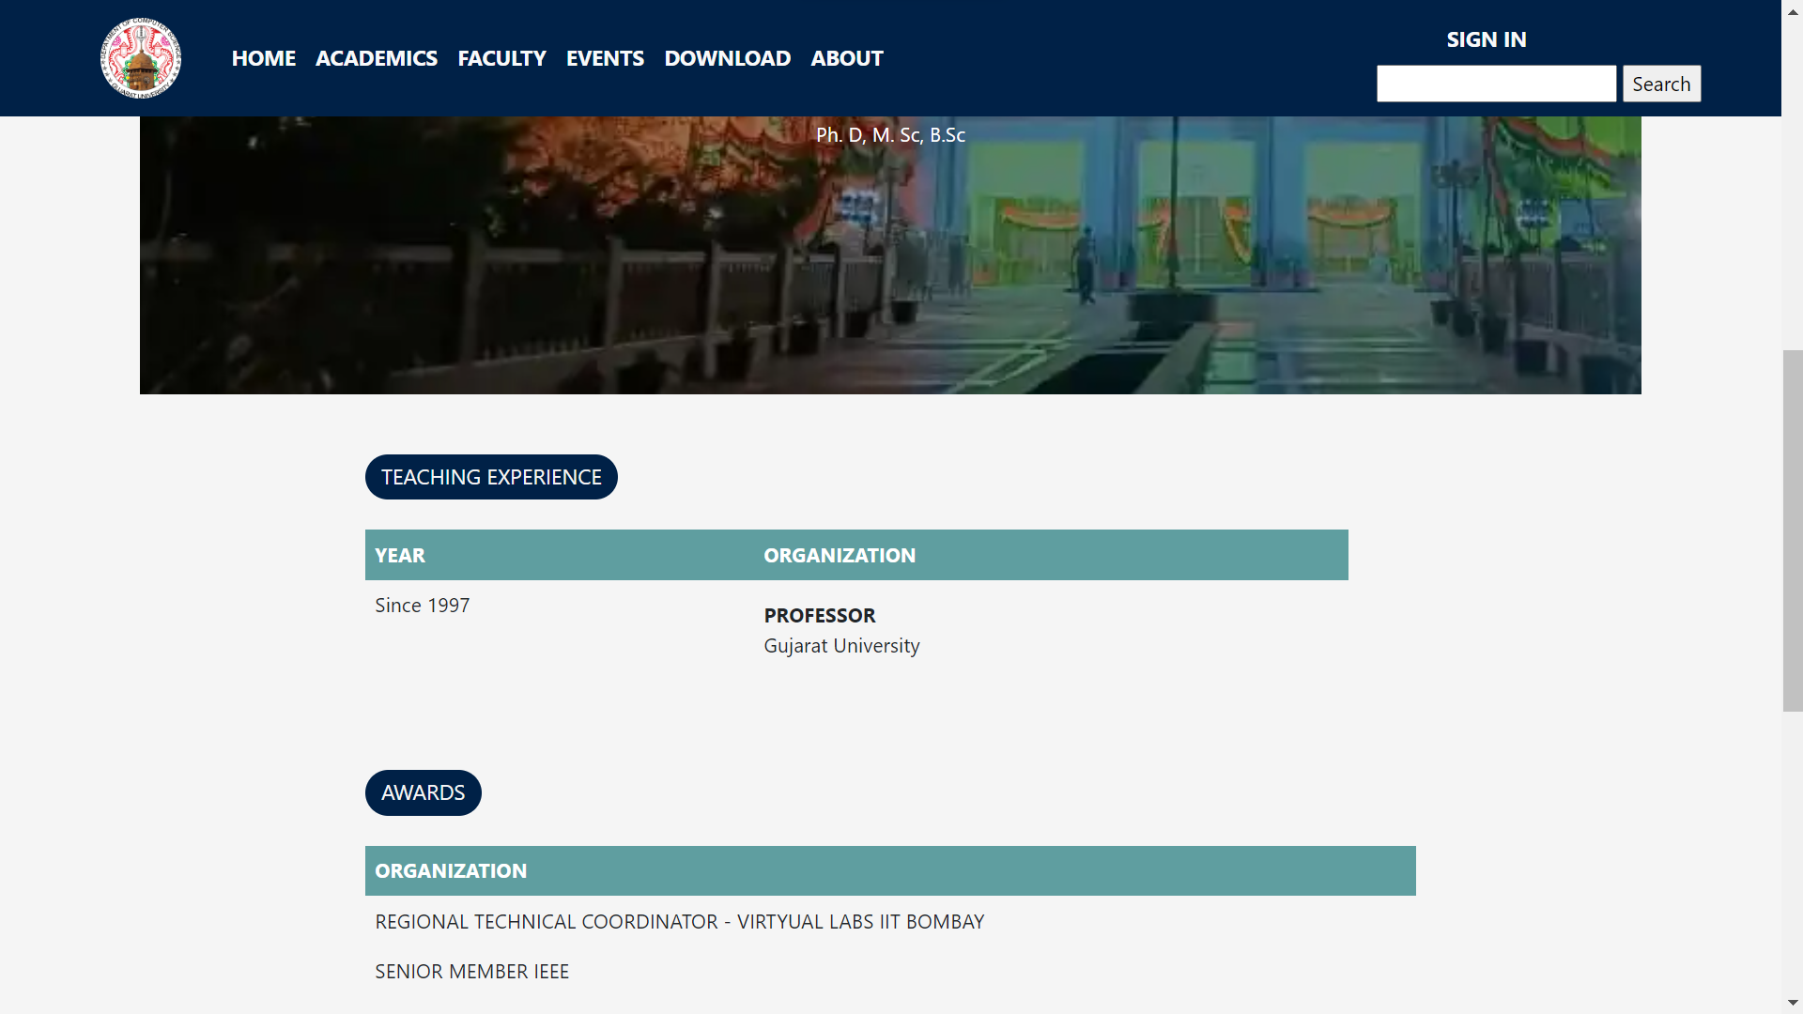
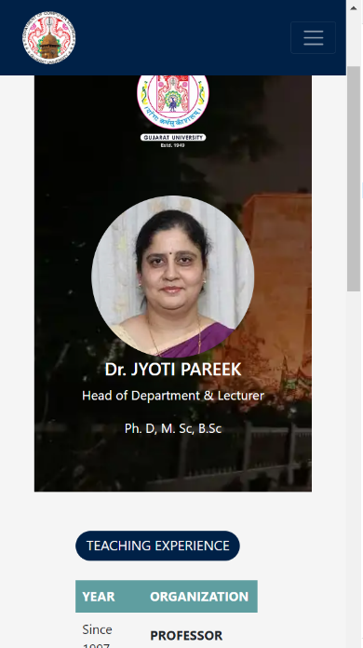
Faculty Page

Slide 36
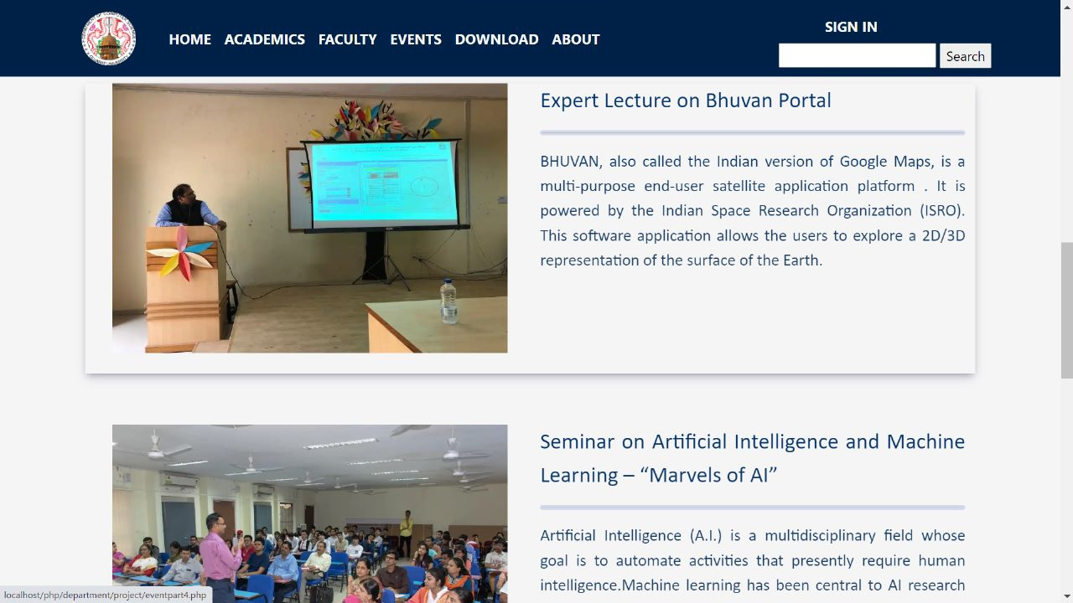
Event Page

Slide 37
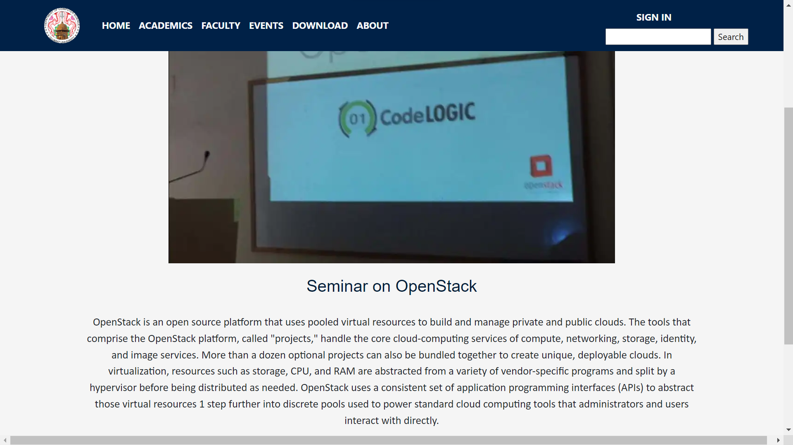
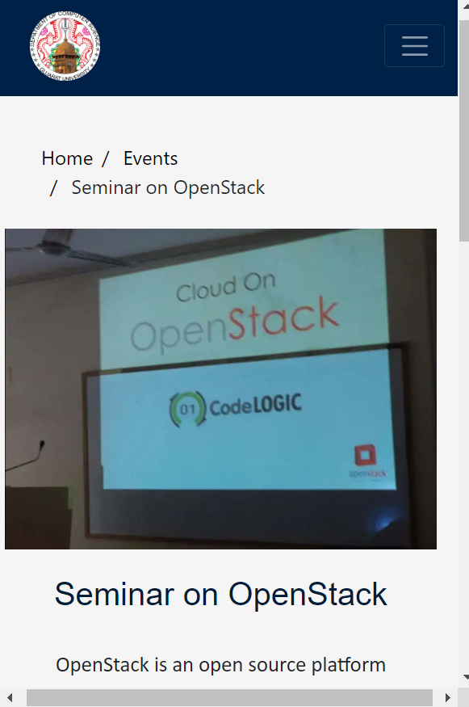
Event Page

Slide 38
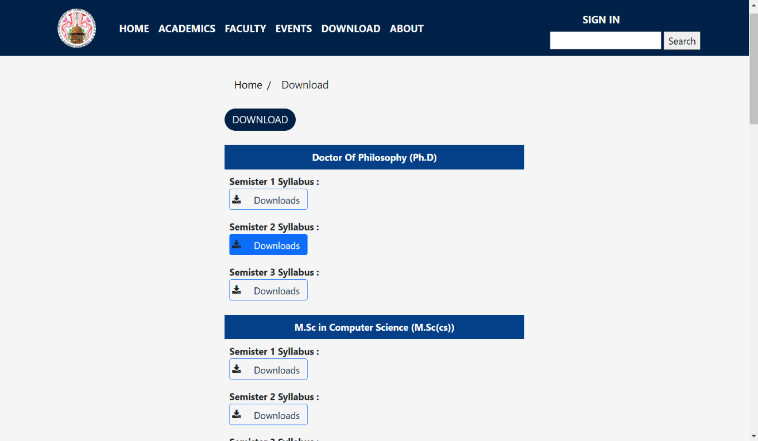
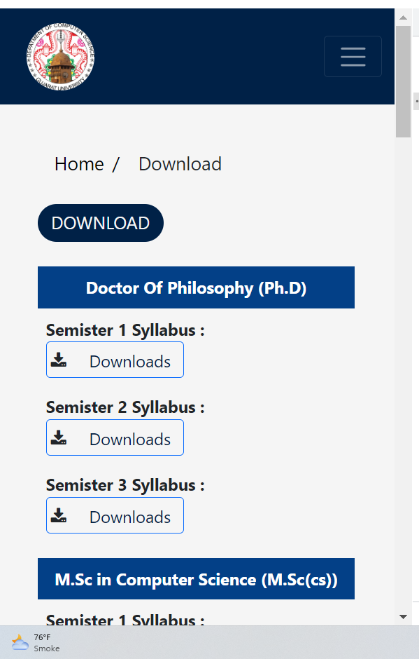
Syllabus Detail

Slide 39
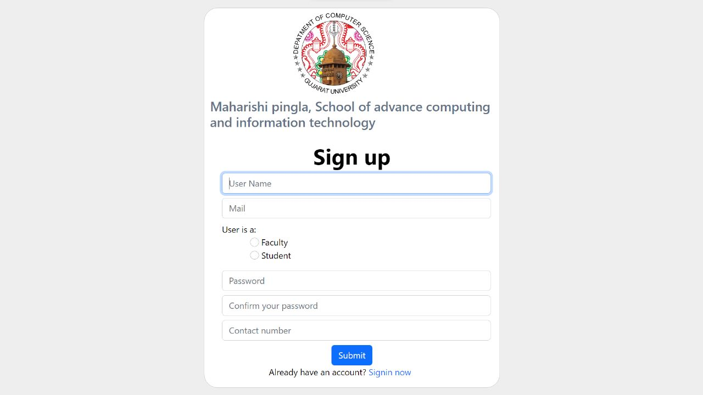
Registration Process

Slide 40
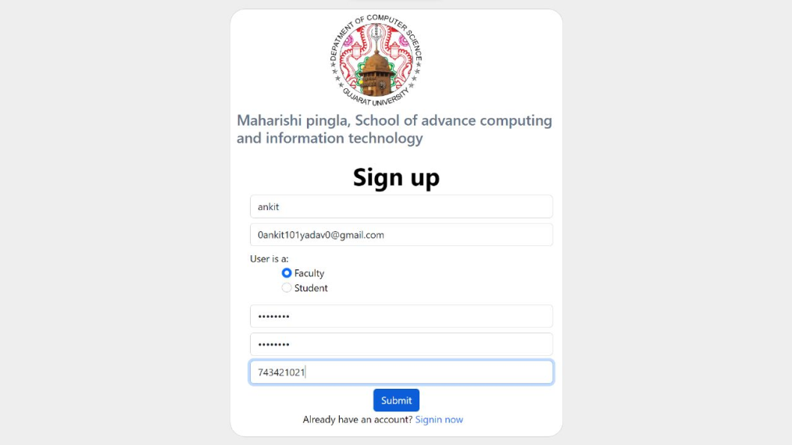
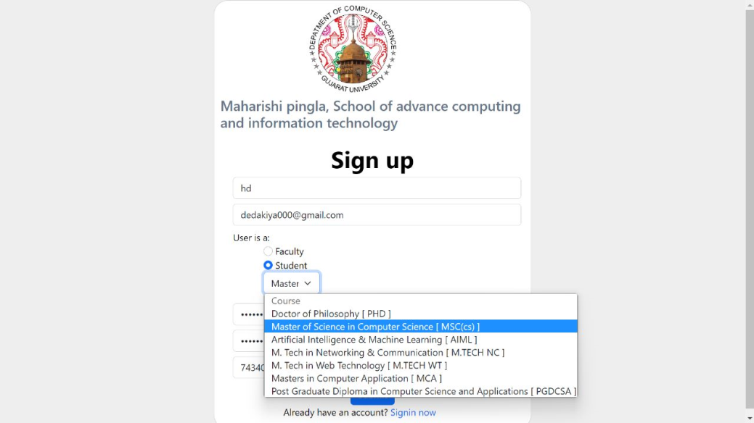
Registration Process

Slide 41
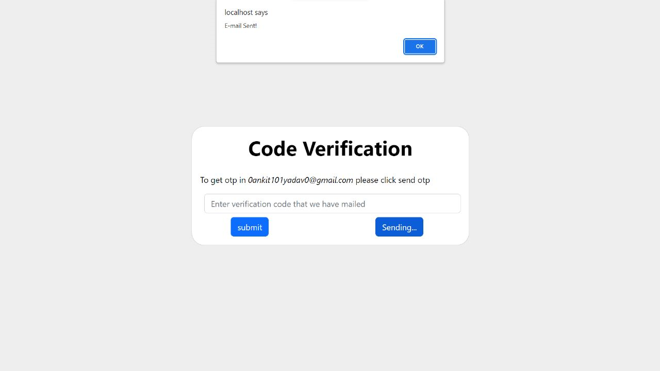
Registration Process

Slide 42
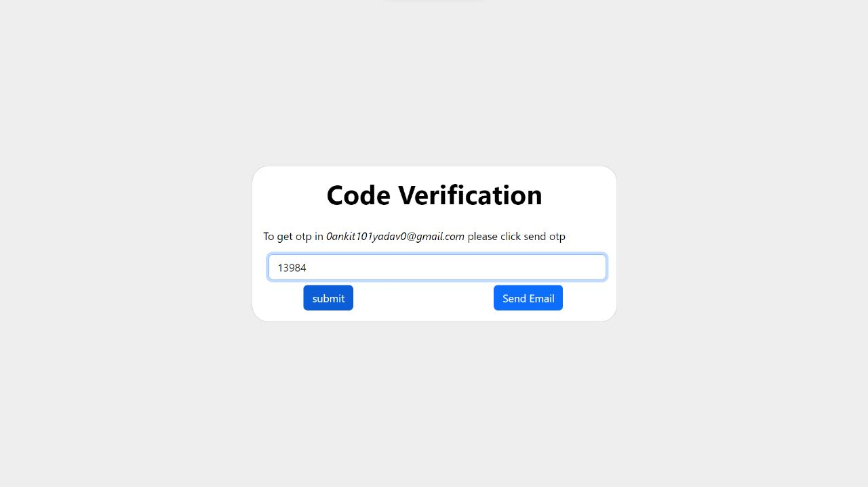
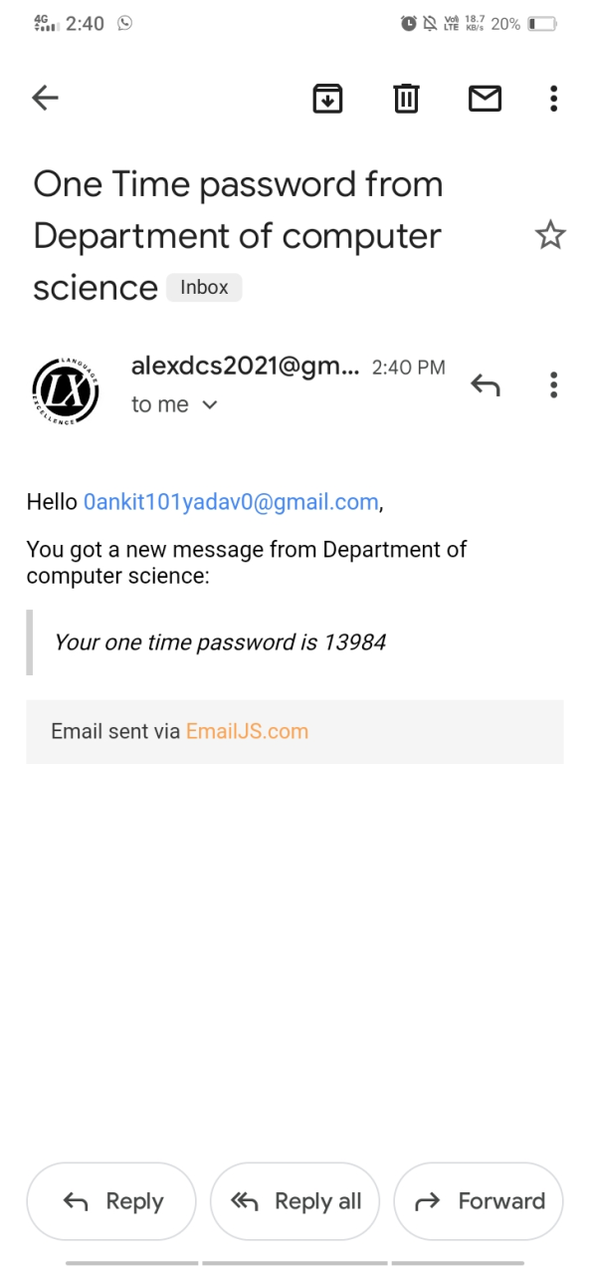
Registration Process

Slide 43
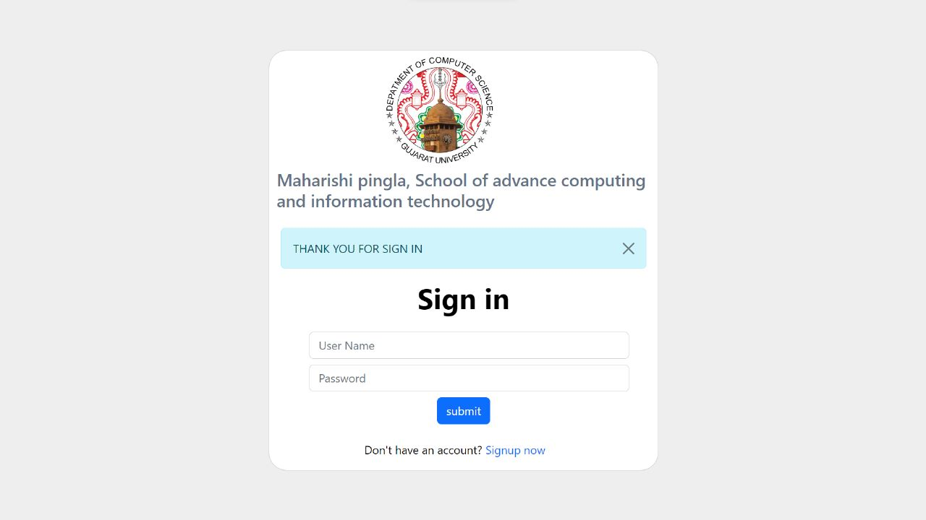
Sign-In As A Faculty

Slide 44
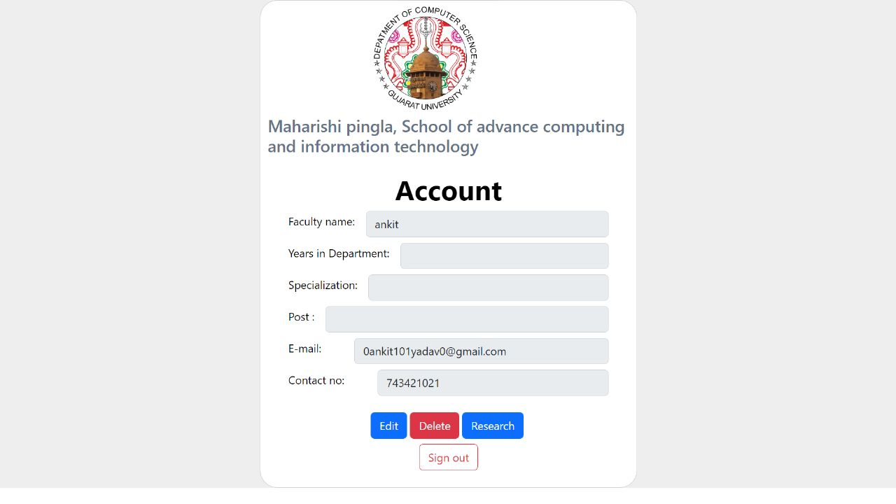
Faculty Detail Update

Slide 45
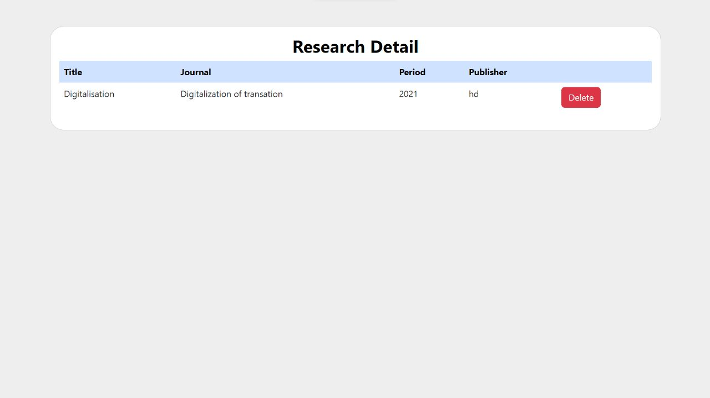
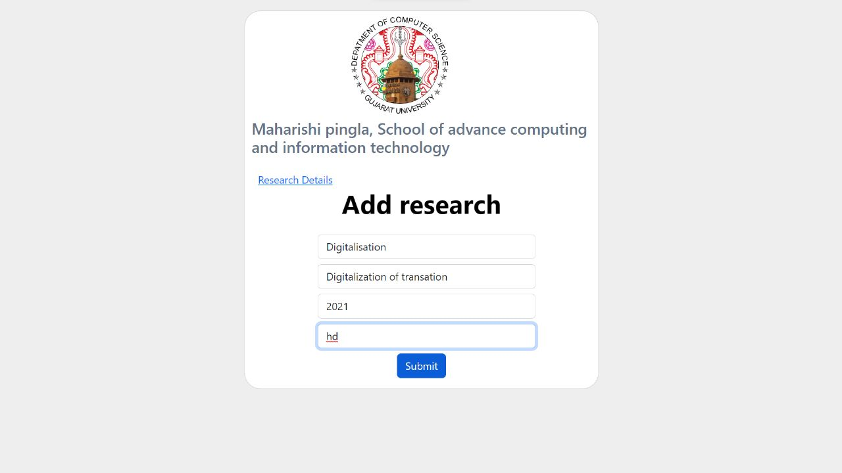
Research Detail

Slide 46
Reg

Slide 47
Future Scope
In Future we are going to initiate new features like – News & Updates , Event Management (by the particular Authorized) , Student can Download Syllabus Pdfs , etc.

Slide 48
Bibliography
References :
https://www.gujaratuniversity.ac.in/
https://nirmauni.ac.in/
https://www.w3schools.com/bootstrap/
https://getbootstrap.com/docs/5.2/getting-started/introduction/
https://www.emailjs.com/

Slide 49
Thank You

